Slide 1
Day 1 - 5

Slide 2



Advance Core Java, Maven and Ant Introduction, Java 8/9 new features

Slide 3

Objective
Learn Advance Java
Learn Maven Fundamentals
Learn Ant Fundamentals
Course Content
Advance Java Programming (Duration -23.5h)
Collections And Generics
Inner Classes
Annotations
Threads Basics
Java 8 new features
Ant and Maven Introduction (Duration -7.5h)
Introduction to Build Tools
Ant Introduction And Setup
Run Sample Build from Ant
Maven Introduction And Setup
Create And Build Maven Project

Slide 4
Module Plan
Day | Activities
Day#1 | Exception, Threads and Essential classes | Java Collection Framework | Java Fundamentals: The Core Platform
Day#2 | Java Fundamentals: The Core Platform | Advance Java
Day#3 | Advance Java | Build Tools - Ant And Maven | Ant Tutorial | Maven Tutorial | Maven Fundamentals
Day#4 | New Features in Java 8 | New Features in Java 9 | Assignment#1
Day#5 | Assignment#1

Slide 5
Study Material
Books
Exception, Threads and Essential classes [3h 30m]
Java Collection Framework [2h 30m]
Ant Tutorial [1h 30m]
Maven Tutorial [1h 30m]
Video Material
Java For Beginners [11h]
Java Generics [1h 15m]
Maven Fundamentals [1h 30m]
New Features in Java 8 [2h]
New Features in Java 9 [1h 30m]

Slide 6
Assignment #1

Slide 7
Problem Statement
Implement a standalone product search program in Java that lists matching products for a user who is looking for T-shirts.
You are given 3 CSV files, each containing the T-shirts data for Nike, Puma and Adidas respectively. Sample CSV files links are attached here for reference. You can add more data in existing files or can add more CSV files for another companies.

Slide 8
Problem Statement …
CSV File Data
CSV Fields | Details
ID | Unique product id, starting with 2-digit company code
NAME | Model name
COLOUR | T-shirt Colour
GENDER_RECOMMENDATION | Gender for which this T-shirt is recommended. M, F, U (M – Male, F- Female, U-Unisex)
SIZE | S, M, L, XL, XXL
PRICE | Price of the T-shirt per piece in INR
RATING | Rating of the T-shirt from 1 to 5 (1 being lowest and 5 being highest)
AVAILABILITY | Y or N

Slide 9
Problem Statement
Input
Program should accept 4 input parameters
Color
Size
Gender
Output Preference
“Gender” is a String which has two possible values like ‘M’ and ‘F’. M=Male and F=Female.
“Output Preference” is a String which suggests whether the results should be sorted only by Price or by Rating or by both Price and Rating.

Slide 10
Expected Behavior and Output
After getting the inputs, program should search for the T-shirts in all 3 csv files and list the results on standard output, sorted by Output Preference.
Program should be written considering that there could be more csv files and at runtime program should load the files. Please make use of Thread which will look for any new file at a particular configurable location after some configurable time and load the provided file
If the suitable T-shirt is not present in any csv files, then program should return a user-friendly error
Assignment should be implemented as a Maven project.
Maven 3.x should be used.
Use available 3rd party dependencies to read and parse CSV files.
Write an ant script to build a jar file for the same java program
Use the new features of Java 8 wherever possible
Output
Program should display the list of available T-shirts with details on console for provided user inputs.

Slide 11
Evaluation Criteria
Code Completeness and Correctness
Use of Java Collections, Threads and Annotations
Usage of OO Principles, package/class structure, class/function/variable names
Code in running condition
Face to face discussion
Usage of Java 8 new features

Slide 12
Day 6 - 9

Slide 13



JDBC, ORM & Hibernate

Slide 14
Learn JDBC, ORM basics and Hibernate
Course Content
JDBC
How to setup JDBC?
JDBC Connections, Statements, Result Sets
JDBC Transactions, Exceptions, Batch processing
ORM And Hibernate
ORM Fundamentals
Hibernate Env. Setup
Define Hibernate Mappings
Use Hibernate for CRUD Operations
Objective
Learn JDBC Usage
Learn ORM Framework

Slide 15
Study Material
Books
JDBC Tutorial [5h]
Hibernate Tutorial [7h]
Video Material
Install MySQL on Windows [6m]
Hibernate Tutorial [3.5h]

Slide 16
Module Plan
Day | Activities
Day#6 | Install MySQL on Windows | JDBC Tutorial | Hibernate Introduction
Day#7 | Hibernate Introduction | Hibernate Tutorial
Day#8 | Hibernate Tutorial | Assignment#2
Day#9 | Assignment#2

Slide 17
Assignment #2

Slide 18
Problem Statement
Implement a standalone product search program in Java, using Hibernate that lists matching products for a user who is looking for T-shirts.
You are given 3 CSV files, each containing the T-shirts data for Nike, Puma and Adidas respectively. Use the same CSV files as provided in Assignment 1. You can add more data in existing files or can add more CSV files for another companies. The data from these files needs to be persisted in the database. All the search operations for the flights will be done on the database using hibernate.

Slide 19
Problem Statement...
CSV File Data Details
CSV Fields | Details
ID | Unique product id, starting with 2 digit company code
NAME | Model name
COLOUR | T-shirt Colour
GENDER_RECOMMENDATION | Gender for which this T-shirt is recommended. M, F, U (M – Male, F- Female, U-Unisex)
SIZE | S, M, L, XL, XXL
PRICE | Price of the T-shirt per piece in INR
RATING | Rating of the T-shirt from 1 to 5 (1 being lowest and 5 being highest)
AVAILABILITY | Y or N

Slide 20
Problem Statement
Input
Program should accept 4 input parameters
Colour
Size
Gender
Output Preference
“Gender” is a String which has two possible values like ‘M’ and ‘F’. M=Male and F=Female.
“Output Preference” is a String which suggests whether the results should be sorted only by Price or by Rating or by both Price and Rating

Slide 21
Expected Behavior and Output
After getting the inputs, program should search for the T-shirts in the database and list the results on standard output, sorted as per Output Preference.
Program should be written considering that there could be more csv files and at runtime program should load the files. Please make use of Thread which will look for any new file at particular location after some configurable time and load the provided file
If no matching flight is found for the given input, user friendly output should be displayed on the screen.
Maven 3.x should be used
Use the new features of Java 8 wherever possible
Output
Program should display the list of available T-shirts with details on console for provided user inputs.

Slide 22
Evaluation Criteria
Code Completeness and Correctness
Database design and use of hibernate technology
Use of Java Collections, Threads and Annotations
Usage of OO Principles, package/class structure, class/function/variable names
Code in running condition
Face to face discussion
Usage of Java 8 new features

Slide 23
Day 10 - 13

Slide 24



Web Server Basics And Web Components

Slide 25
Web Server And Components
Course Content
Web Server Basics(Duration -5h)
Web Server And Application Server Introduction
Know About Tomcat
Configure Tomcat with Eclipse
Web Components (Duration -15h)
JSP And Servlet Basics
JSP Standard Tag Library [JSTL]
Web Application Structure
Sample Web Application
Objective
Web Server And Application Server Basics
Learn Web Components
Develop Web Application

Slide 26
Module Plan
Day | Activities
Day#10 | Webserver And Application Server Basics | Tomcat Basics | Tomcat Advanced | Configuring Tomcat in Eclipse Pdf | Java Web Fundamentals
Day#11 | Creating a Web App Using Eclipse | JSP And Servlet Tutorial | Servlet Tutorial
Day#12 | JSP Tutorial | Assignment#3
Day#13 | Assignment#3

Slide 27
Study Material
Books
Tomcat Basics [2h]
Tomcat Advanced [2h]
Configuring tomcat in eclipse [1h] –(Study Material)
Servlet Tutorial [4h]
JSP Tutorial [4h]
Video Material
Creating a Web App Using Eclipse [15m]
JSP And Servlet Tutorial [4h]
Java Web Fundamentals [2h 28m]

Slide 28
Assignment #3

Slide 29
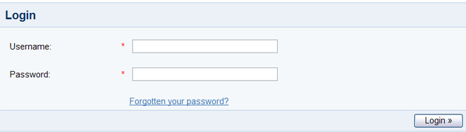
Problem Statement
Develop an ecommerce product management utility. This utility begins by presenting a login screen that looks like this
Admin user would enter a username and password for authentication. Upon clicking the Login button, the submitted username / password should be verified (authenticated) against existing users' information in the database.
Upon successful authentication, the user would be presented with a screen as follows:

Slide 30
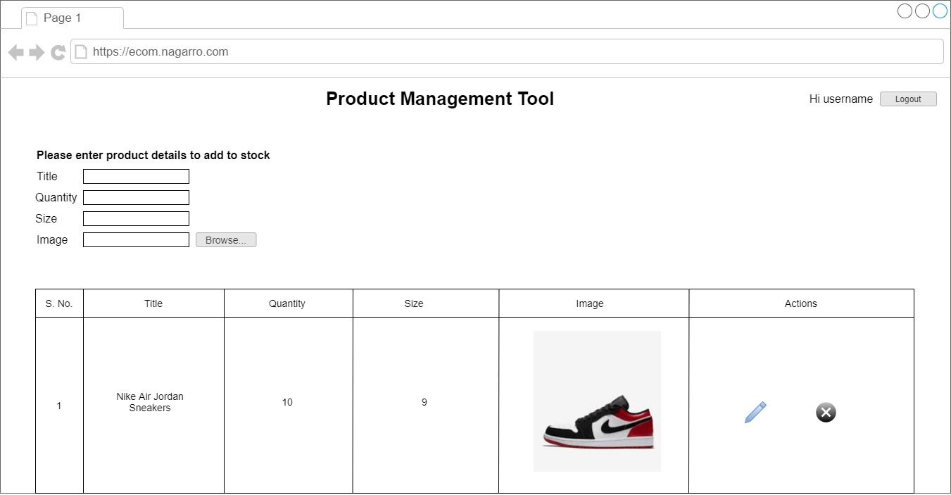
Problem Statement…
User should be allowed to edit (change the added product’s attributes viz. title, quantity, size, image) and delete the product and total size of the uploaded products should be displayed at the bottom of the listing on the same page.

Slide 31
Expected Behavior and Output
Constraints
Max size of a single product’s uploaded image should be 1 MB
Max size of all uploaded product’s images should be 10 MB
Key Points
Design appropriate data model and object model
Proper validation and info messages should be shown on console wherever required
Exception Handling is required
Make use of Hibernate Technology for Data Base connectivity
While writing APIs no SQL scripts should be used instead use Hibernate POJOs and HQL
Tomcat version 8 or above and hibernate 5.x should be used.

Slide 32
Evaluation Criteria
Code Completeness and Correctness
Usage of OO Principles, package/class structure, class/function/variable names
Code Modularity
Code should be in running condition
Face to face discussion
Data base design and proper use of hibernate technology
Ability to deploy WAR application on application server without using IDE
Adhere to Java Coding Standards And Guidelines

Slide 33
Day 14 - 17

Slide 34

Spring and Spring Hibernate Integration

Slide 35

Spring And Spring Hibernate Integration
Course Content
Spring Basics
Introduction
Spring Architecture
Spring Env. Setup
Write a small “Hello world” Example
Spring Core
IOC/Dependency Injection
Validation, Data Binding and Type Conversion
Spring AOP
Transaction Management
Spring MVC
Spring JDBC Framework
Hibernate with Spring
Objective
Develop Web Application using Spring
Spring Hibernate Integration
Understanding Coding Guidelines and Best Practices

Slide 36
Module Plan
Day | Activities
Day#14 | Spring Env Setup | Spring Fundamentals | Web Applications with Spring |Spring Tutorials Pdf [Spring Architecture]
Day#15 | Spring with JPA and Hibernate | Spring MVC Introduction
Day#16 | Spring Hibernate Integration | Spring Framework Reference | Assignment#4
Day#17 | Assignment#4

Slide 37
Study Material
Books
Spring Tutorial [5h]
Spring-framework-reference [8h] – (Study Material)
Video Material
Spring Fundamentals [1h 30m]
Spring MVC Tutorial 1 [2h]
Spring MVC Tutorial 2 [1h]
Spring Hibernate Integration [22m]

Slide 38
Assignment #4

Slide 39
Problem Statement
Extend Assignment #2 to implement a product search Web Application using Spring, Hibernate technology that lists matching products for a customer who are looking to buy T-shirts
Instead of providing input on console, users will use a web application to input. The web application must be developed using Spring MVC. Spring and Hibernate integration has to be implemented.

Slide 40
Problem Statement
Input
Program should accept 4 input parameters
Colour
Size
Gender
Output Preference
“Gender” is a String which has two possible values like ‘M’ and ‘F’. M=Male and F=Female.
“Output Preference” is a String which suggests whether the results should be sorted only by Price or by Rating or by both Price and Rating

Slide 41
Expected Behavior and Output
Program should be written considering that there could be more csv files and at runtime program should load the files. Please make use of Thread which will look for any new file at particular location after some configurable time and load the provided file
Create a login Page for the application and after successful login Product Search Screen will be displayed
Search screen should have all input parameters specified in previous slides as Color, Size, Gender and output preference
Once Search is triggered after specifying the search parameters, program will display the search results from the database using hibernate
Use Spring MVC and Spring - Hibernate Integration
Spring version 3 or 4 should be used

Slide 42
Evaluation Criteria
Code Completeness and Correctness
Usage of Spring Framework And Hibernate
Code Modularity
Code should be in running condition
Face to face discussion
Application UI Design

Slide 43
Day 18 - 22

Slide 44


Web Services

Slide 45
Spring And Spring Hibernate Integration
Course Content
Basics
Introduction
REST Core Components
SOAP Core Components
Advance
RESTful Architecture
HTTP methods
Jackson
Validations
Filters
Spring Boot
Objective
Develop Web Application using Spring MVC and Spring boot

Slide 46
Module Plan
Day | Activities
Day#18 | REST Webservices Basics | REST Webservices | SOAP | WSDL
Day#19 | SOAP Webservices Basics
Day#20 | Spring Boot Introduction & RESTful API with Spring Boot
Day#21 | Assignment#5
Day#22 | Assignment#5

Slide 47
Study Material
Books
REST Webservices Basics (Refer chap. 20) [4h]
REST Webservices [2h]
SOAP [30m]
WSDL [30m]
SOAP Webservices Basics (Refer chap. 16) [4h]
Video Material
Your first Spring Boot Application [2h]

Slide 48
Assignment #5

Slide 49
Problem Statement
Develop a web application (Application 1) using Spring MVC and JSP for Library Management. A librarian can login to application and manage books.
However, the details of the books and authors are maintained on a separate server (Application 2) which exposes RESTful webservices using Spring Boot to support CRUD operations on books data.
A book must be associated with an author. Authors needs to be configured in Database (not to be added through UI). While adding a book, authors will be shown in the dropdown to choose from the list.
REST APIs for CRUD operations on Author has to be provided, however no separate UI is needed for Author Management.
Following functionalities are expected
Librarian Login/Logout
Books listing
Add a book
Edit a book details
REST APIs for CRUD operations on authors data
REST APIs for CRUD operations on books data

Slide 50
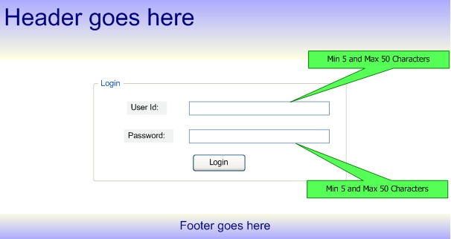
Application UI
Librarian Login

Slide 51
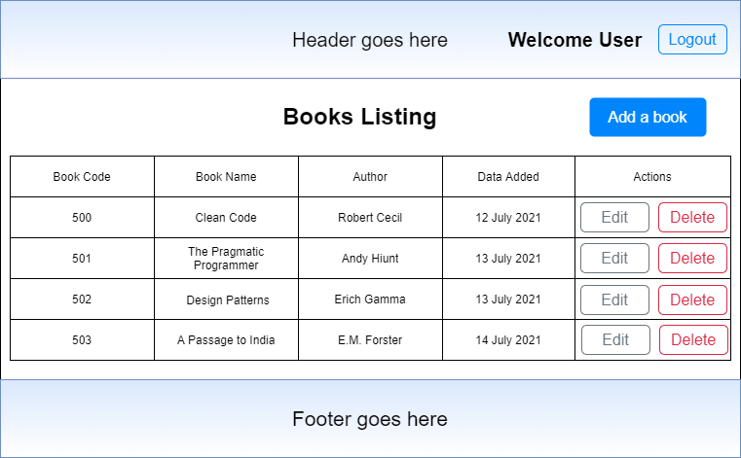
Application UI
List Book Details

Slide 52
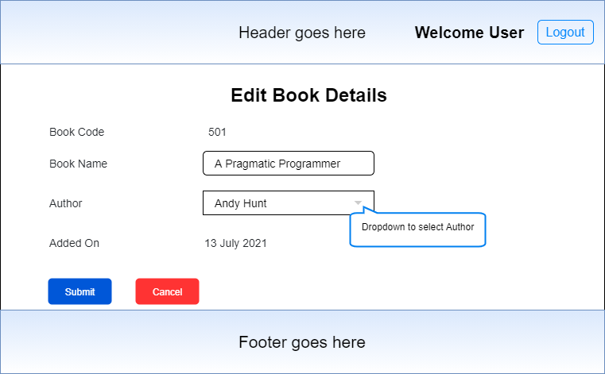
Application UI
Edit Book Details

Slide 53
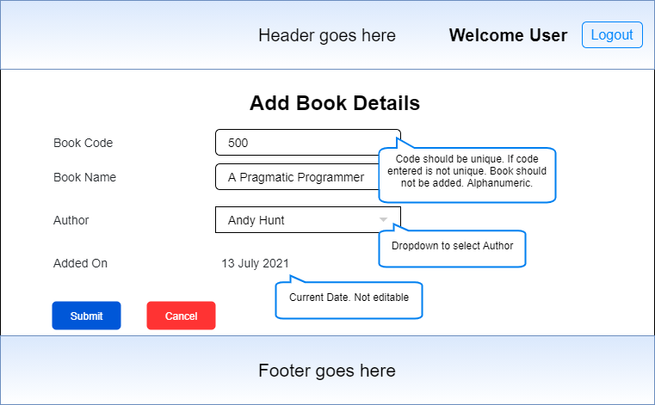
Application UI
Add Book Details

Slide 54
Expected Behavior and Output
The complete assignment should be done using Spring MVC, Tomcat, Spring Boot and Hibernate only.
Well documented HTML, JS and CSS files
Code should follow Java Coding Standards, Guidelines and best practices
Follow best practices for restful webservices
Use of appropriate HTTP codes and exception handling for REST APIs.
Server to server webservice communication

Slide 55
Evaluation Criteria
Code correctness
Code modularity
Code should be in running condition
Use of Spring Boot
Face to face discussion
Adhere to Java Coding Standards And Guidelines
Implementation of 3-tier architecture

Slide 56
Day 23 - 25

Slide 57


DevOps – CI/CD

Slide 58
DevOps
Course Content
Build and CI
What is CI?
Know About Jenkins
Jenkins Setup
Creating a pipeline
Sonar Setup for Jenkins
Accessing Build And Sonar Reports
Objective
Create a CI-CD pipeline in Jenkins

Slide 59
Module Plan
Day | Activities
Day#23 | Build and CI-CD
Day#24 | Build and CI-CD | Assignment#6
Day#25 | Assignment #6

Slide 60
Study Material
Books
Jenkins And Sonar Build Process – (Study Material)
Video Material
Introduction to DevOps
What is CI CD
Understanding CI Process with Jenkins[1h]
Integrating Sonarqube & Jenkins

Slide 61
Assignment #6

Slide 62
Problem Statement
Create CI-CD pipelines for the applications already developed in Assignment #5. Two separate pipelines need to be created; one for Spring MVC application and one for the spring boot application. Only pipelines need to be created and code will be re-used from Assignment #5.
The build should get automatically triggered if there are any new commits in the repository.

Slide 63
Expected Behavior and Output
The complete assignment should be done using Jenkins and required plugins only.
The pipelines should pass with BUILD SUCCESS.
Assignment submission will be a demo and mentee must present the created pipelines to the respective mentor.

Slide 64
Evaluation Criteria
Pipelines Completeness and Correctness
Pipelines in running condition
Face to face discussion

